Slide 1
RADIO IMAGING FOR COLLEGE STATIONS
Presented by: Greg Weston, University of Pittsburgh
October 24, 2015
National Student Electronic Media Convention
Minneapolis, MN

Slide 2
THE MAIN POINTS
A UNIQUE STATION BRAND IS VITAL TO DEVELOPING LISTENER LOYALTY
A STRATEGIC PHILOSOPHY MUST BE DEVELOPED TO CREATE EFFECTIVE IMAGING
AN EMOTIONAL CONNECTION TO THE LISTENER WILL SET YOUR STATION APART

Slide 3
THE GOALS OF IMAGING
Identify the station
Present a positive, consistent image of the station
Inform the listener about station programming and events
Cycle your listeners to other dayparts
Increase listener loyalty

Slide 4
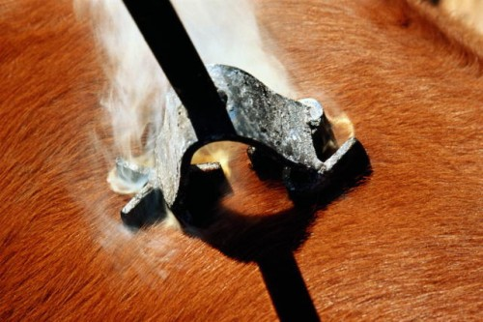
BRAND:
“In marketing, the sum total of a company's value, including products, services, people, advertising, positioning, and culture.”

Slide 5
BRANDING:
“A brand never about the product and always about the promise.”
- Jay Ehret, The Marketing Spot

Slide 6
BRANDING:
“A brand is not an icon, a slogan or a mission statement. It is a promise – a promise your company can keep.”
- Kristen Zhivago, Business Marketing

Slide 7
BRANDING:
"A brand is a collection of perceptions in the mind of the consumer."
- WWW.BUILDINGBRANDS.COM

Slide 8
BRANDING:
CONSISTENCY
FREQUENCY
ANCHORING
- Roy Williams, Secret Formulas of the Wizard of Ads

Slide 9

“Brand aligns with individual identity” - Disney Institute

Slide 10
8 EMOTIONS TOWARDS BRANDS
Approachability
Relevance
Admiration
Curiosity
Identification
Empowerment
Understanding
Pride

Slide 11
STATIONALITY
“STATION” + “PERSONALITY”
OVERALL “FEEL” OF THE STATION
ANYONE LISTENING AT ANY TIME SHOULD IMMEDIATELY BE ABLE TO IDENTIFY THE STATION

Slide 12
How can a college station develop stationality?
Consistent formatics
Consistent sound to non-music elements
Consistent reference to brand (via slogan)
Synthesize brand into one word and make sure it permeates station

Slide 13
GOOD SLOGANS:
Communicate the station’s brand
Make a promise
Own a value that’s important to the listeners
Are concise

Slide 14
BAD SLOGANS:
Make tangible claims
Brag
Lack emotional connection
Make promises you don’t keep

Slide 15
THE KEY IS FORMING AN EMOTIONAL CONNECTION TO YOUR LISTENERS!

Slide 16
STEP 1: KNOW YOUR LISTENERS
DEMOGRAPHIC PROFILE
RACE/ETHNICITY
CLASS
SEX
AGE
JOB
FAMILY STATUS
STUDENT STATUS

Slide 17
STEP 2: UNDERSTAND YOUR LISTENERS
WHAT ARE THEIR HOBBIES AND INTERESTS?
WHAT’S ON THEIR MINDS?
WHAT ARE THEIR PERSONALITY TRAITS?
WHY DO THEY LISTEN?
WHAT DO THEY VALUE ABOUT THEMSELVES?
WHERE DO THEY WANT TO GO?

Slide 18
STEP 3: CREATE A PROTOTYPICAL LISTENER
START WITH DEMOGRAPHICS AND THEN GO DEEPER
PERSONALITY TYPE
ACTIVITIES
LIKES AND DISLIKES
WHEN/HOW THEY LISTEN
WHAT ARE THEY FEELING

Slide 19
STEP 4: TAILOR YOUR IMAGING TO THEM
TALK ABOUT WHAT THEY’RE TALKING & THINKING ABOUT
MAKE REFERENCES THEY GET
MAKE IT FEEL LIKE A CLUB
WHAT TYPE OF PERSON
IS YOUR STATION?

Slide 20
WHAT CAN YOU PROMOTE?
Brand/Slogan/Image
Format/Music
Stream/Website/Social Media
Contests
Shows/Personalities
Events/Concerts
Non-commerciality
Awards
University Affiliation

Slide 21
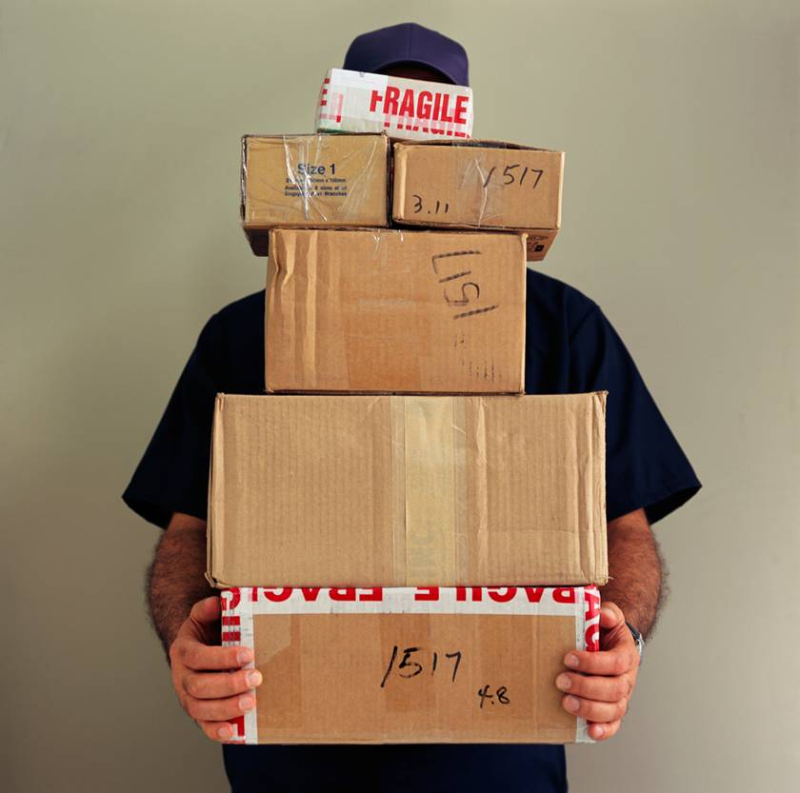

METHODS OF DELIVERY
PROMOS
LINERS/BUMPS/SWEEPERS
LEGAL IDs
LIVE DJ READS

Slide 22
DEVELOPING THE IMAGING
CREATE A CALENDAR
DIRECTED BRAINSTORMING
SCHEDULE WISELY

Slide 23

1. CALENDAR
SCHOOL SCHEDULE
STATION EVENTS
COMMUNITY EVENTS
SPECIAL BROADCASTS
WHATEVER ELSE IMPACTS THE LISTENER

Slide 24
2. BRAINSTORMING
REVIEW CALENDAR
DISCUSS WHAT’S HOT
CONNECT IT TO THE STATION
STAY ON MESSAGE
FIND DIFFERENT WAYS TO SAY THE SAME THING
CREATE CREATIVELY

Slide 25
3. SCHEDULE WISELY
1 PROMO, 2 LINERS, 2 DJ READS PER HOUR
USE A GRID
PROMOTE VERTICALLY AND HORIZONTALLY
PRIORITIZE
JUMP ON AND OFF EARLY

Slide 26
COMMON IMAGING PROBLEMS
STALE PROMOS
POOR IDENTIFICATION OF STATION
MISPLACED PRIORITIES
INSUFFICIENT PROMOTION OF EVENTS
SPEAKING TO THE WRONG AUDIENCE
POOR DAYPARTING
LACK OF ENTERTAINMENT VALUE

Slide 27
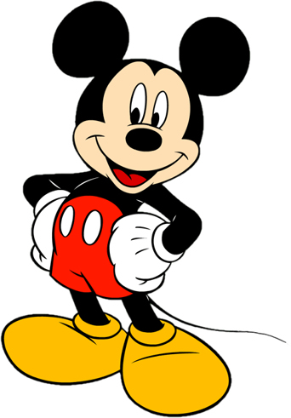
DISNEY’S SIX STEPS TO CREATING CUSTOMER LOYALTY
IDENTIFY YOUR CUSTOMERS
ALIGN YOUR PROMISE
IDENTIFY YOUR STRENGTHS
DELIVER YOUR STRENGTHS
VALUE YOUR EMPLOYEES
CONNECT EMOTIONALLY

