Slide 1

Building an Effective Advisory Board for Your Media Outlet
Warren “Koz” Kozireski
SUNY-Brockport, General Manager, WBSU
Mark Maben
Seton Hall University, General Manager WSOU
Glenn Schuck
Reporter/Anchor 1010 WINS New York City
WSOU Advisory Board Member

Slide 2

Why Form An Advisory?

Slide 3
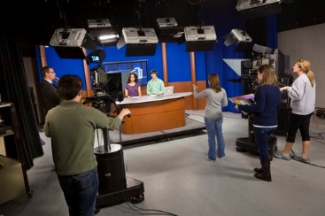

Whether your outlet’s mission is pre-professional or a student activity, having an advisory board has its benefits

Slide 4
Advisory Boards Can:
Provide feedback on mission/goals, programming, and service to the community
Help formulate policies and procedures
Give guidance on current industry trends and technology
Share expertise
Secure resources for your media outlet
Advocate for your station on campus and the broader outside community
Have your back

Slide 5
Advisory Boards Can:
Be a sounding board for new ideas or proposed changes
Provide evaluation and assessment when required by your school
Mentor
Help you Network
Open opportunities for internships and jobs
Build greater awareness for your media outlet
Enhance your media outlet’s credibility and reputation
Play devil’s advocate
Have your back (worth repeating!)

Slide 6
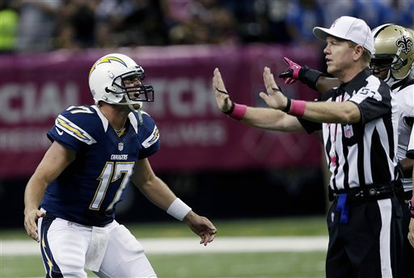
Worried About Autonomy or Interference?
An Advisory Board is there to provide
informed but non-binding guidance

Slide 7
Advisory Boards Shouldn’t:
Have operational authority over your media outlet
A say in day-to-day management decisions
Decision-making authority over programming
The ability to fire student staff members
Budgetary control

Slide 8
Board Composition
Members can include the following types of individuals:
Administrators
Faculty
Students
Alumni
Local industry professionals
Civic leaders
Government officials
School trustee/regent
Volunteers
Others

Slide 9
Keys to Success
A study by the Station Resource Group found four essential elements for effective advisory boards:
A clear mission
Strong recruitment
Member succession plan (including term limits)
Commitment from staff

Slide 10
Keys to Success
In addition, we add the following as ingredients for success:
Set expectations
Run productive meetings
Engage board members beyond regular meetings
Keep board members informed
Listen to what your members have to say and don’t be defensive
Show and tell

Slide 11
Structure
Remember, the board should be designed as solely advisory in nature.
What to call it?
How big?
How often?
Where?
Open or closed?
Policies and procedures

Slide 12
Example: WBSU
2 current student station members
2 students appointed by Student Government
1 College Senate
1 Communication Dept. Faculty
1 College President appointee
1 Vice President Student Affairs appointee
1 Community member (appointed by the College President)

Slide 13
Example: WSOU
Dean of the College of Communication and the Arts
University Provost (or his/her designee)
A Faculty Member from within the College of Communication and the Arts
A Faculty Member from outside of the College
Station’s General Manager and Chief Engineer
WSOU Student Station Manager and Staff Representative
Two WSOU Alumni Members
Two Members from the Broadcasting and/or Music Industries
A Representative from the Archdiocese of Newark
Additional members can be added to the Advisory Board but composition of the Board cannot exceed 21 members.

Slide 14
Potential Pitfalls
Time Commitment
Lack of Commitment from Board Members
Interference by Board Members
Intimidation
Lack of Confidentiality

Slide 15

If you are in this room and your media outlet receives funding from the Corporation for Public Broadcasting (CPB), raise your hand please.

Slide 16
Final Thoughts
It is work to start it up, but it is worth it
Get student buy-in
Stay committed
More on “Got Your Back”

Slide 17



Thank You!

Slide 18


