Slide 1
RADIO IMAGING FOR COLLEGE STATIONS
Presented by:
Greg Weston, University of Pittsburgh
October 28, 2010
National College Media Convention
Louisville, KY

Slide 2
THE MAIN POINTS
A UNIQUE STATION BRAND IS VITAL TO DEVELOPING LISTENER LOYALTY
A STRATEGIC PHILOSOPHY MUST BE DEVELOPED BEFORE EFFECIVE IMAGING CAN BE CREATED
AN EMOTIONAL CONNECTION TO THE LISTENER WILL SET YOUR STATION APART.

Slide 3
DEFINITIONS
PROGRAMMING: THE ON-AIR CONTENT OF YOUR STATION
IMAGING: ALL NON-PRIMARY PROGRAMMING ELEMENTS BROADCAST ON YOUR STATION
PROGRAMMING ELEMENTS INCLUDE:
MUSIC
TALK SHOWS
SPORTING EVENTS
NEWS/SPORTS UPDATES
PROMOS
LINERS/SWEEPERS/BUSTERS
PSAs
UNDERWRITING
LEGAL IDs
MIC BREAKS

Slide 4
THE GOALS OF IMAGING
Identify the station
Present a positive, consistent image of the station
Inform the listener about station programming and events
Cycle your listeners to other dayparts
Increase listener loyalty

Slide 5
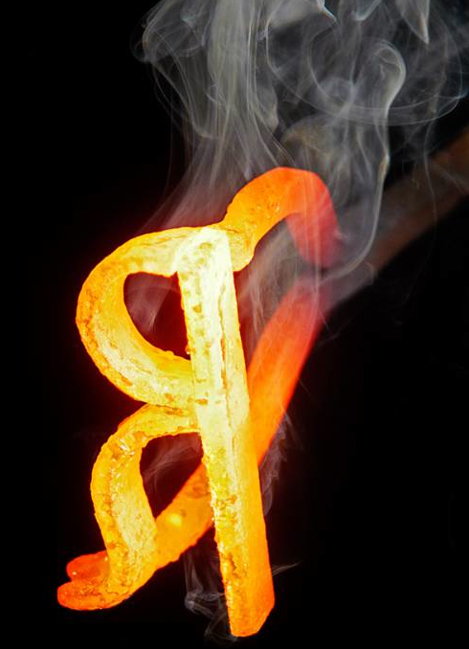
BRAND:
“In marketing, the sum total of a company's value, including products, services, people, advertising, positioning, and culture.”

Slide 6
BRANDING:
“A brand never about the product and always about the promise.”
- Jay Ehret, The Marketing Spot

Slide 7
BRANDING:
"A brand is a collection of perceptions in the mind of the consumer."
- WWW.BUILDINGBRANDS.COM

Slide 8
BRANDING:
CONSISTENCY
FREQUENCY
ASSOCIATION
- Roy Williams, Secret Formulas of the Wizard of Ads
Notes:
Pavlov’s Dogs. Radio company that gets branding.

Slide 9

“Brand aligns with individual identity.” Disney Institute

Slide 10
STATIONALITY
“STATION” + “PERSONALITY”
OVERALL “FEEL” OF THE STATION
ANYONE LISTENING AT ANY TIME SHOULD IMMEDIATELY BE ABLE TO IDENTIFY THE STATION

Slide 11
How can a college station develop stationality?
Consistent formatics
Consistent sound to non-music elements
Consistent reference to brand (via slogan)
Synthesize brand into one word and make sure it permeates station

Slide 12
SLOGANS SHOULD:
Communicate the station’s brand
Make a promise
Own a value that’s important to the listeners
Remind staff of brand promise
Avoid tangible claims

Slide 13
SLOGANS
GOOD
BAD
Pittsburgh’s Progressive FM
Where the Music Matters
Truth FM
The Station That Loves You
Your 10-in-a-Row Station
Best Variety

Slide 14
THE KEY IS FORMING AN EMOTIONAL CONNECTION TO YOUR LISTENERS!

Slide 15
STEP 1: KNOW YOUR LISTENERS
DEMOGRAPHIC PROFILE
  RACE/ETHNICITY
  CLASS
  SEX
  AGE
  JOB
  FAMILY STATUS
  STUDENT STATUS

Slide 16
STEP 2: UNDERSTAND YOUR LISTENERS
WHAT ARE THEIR HOBBIES AND INTERESTS?
WHAT’S ON THEIR MINDS?
WHAT ARE THEIR PERSONALITY TRAITS?
WHAT NEEDS DO THEY HAVE?
WHY DO THEY LISTEN?
WHAT DO THEY VALUE ABOUT THEMSELVES?

Slide 17
STEP 3: CREATE TYPICAL LISTENERS & TAILOR YOUR IMAGING TO THEM
TALK ABOUT WHAT THEY’RE TALKING & THINKING ABOUT
MAKE REFERENCES THEY GET
MAKE IT FEEL LIKE A CLUB
WHAT TYPE OF PERSON
IS YOUR STATION?

Slide 18
WHAT CAN YOU PROMOTE?
Brand/Slogan/Image
Format/Music
Stream
Website/New Media Applications
Shows/Personalities
Events/Concerts
Non-commerciality
Awards
Technical Improvements
University Affiliation

Slide 19
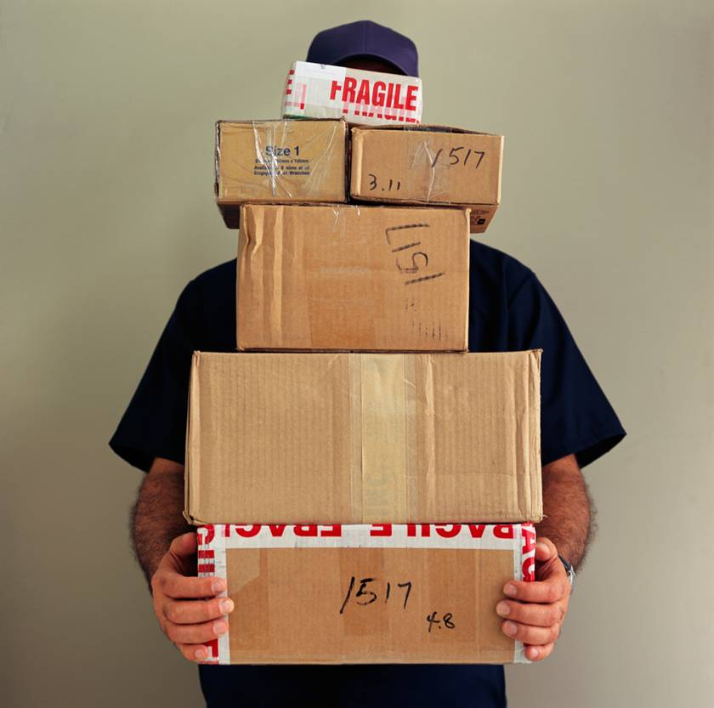
METHODS OF DELIVERY
PROMOS
LINERS/BUMPS/BUSTERS
LEGAL IDs
LIVE DJ READS

Slide 20
DEVELOPING THE IMAGING
CREATE A CALENDAR
DIRECTED BRAINSTORMING
SCHEDULE WISELY

Slide 21

1. CALENDAR
SCHOOL SCHEDULE
STATION EVENTS
COMMUNITY EVENTS
SPECIAL BROADCASTS
WHATEVER ELSE IMPACTS THE LISTENER

Slide 22
2. BRAINSTORMING
REVIEW CALENDAR
DISCUSS WHAT’S HOT
  CONNECT IT TO THE STATION
STAY ON MESSAGE
  FIND DIFFERENT WAYS TO SAY THE SAME THING
CREATE CREATIVELY

Slide 23
3. SCHEDULE WISELY
1 PROMO, 2 LINERS, 2 DJ READS PER HOUR
  USE A GRID
PROMOTE VERTICALLY AND HORIZONTALLY
PRIORITIZE
JUMP ON AND OFF EARLY

Slide 24
COMMON IMAGING PROBLEMS
STALE PROMOS
POOR IDENTIFICATION OF STATION
MISPLACED PRIORITIES
INSUFFICIENT PROMOTION OF EVENTS
SPEAKING TO THE WRONG AUDIENCE
POOR DAYPARTING
LACK OF ENTERTAINMENT VALUE

Slide 25

DISNEY’S SIX STEPS TO CREATING CUSTOMER LOYALTY
IDENTIFY YOUR CUSTOMERS
ALIGN YOUR PROMISE
IDENTIFY YOUR STRENGTHS
DELIVER YOUR STRENGTHS
VALUE YOUR EMPLOYEES
CONNECT EMOTIONALLY

Slide 26
FOR COPIES OF THIS PRESENTATION: grw8@pitt.edu
HAPPY HALLOWEEN!

